Slide 1
Dynamic programming
Introduction

Slide 2
What is Dynamic Programming?
A method for solving complex problems by breaking them into smaller, easier, sub problems
Term Dynamic Programming coined by mathematician Richard Bellman in early 1950s
  employed by Rand Corporation
  Rand had many, large military contracts
  Secretary of Defense, Charles Wilson “against research, especially mathematical research”
  how could any one oppose "dynamic"?

Slide 3
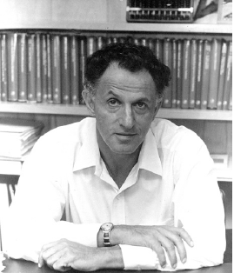
Who developed Dynamic Programming?
"Thus, I thought dynamic programming was a good name. It was something not even a Congressman could object to. So I used it as an umbrella for my activities"
- Richard E. Bellman

Slide 4
Dynamic Programming
A generalization of iteration and recursion.
“Dynamic Programming is recursion’s somewhat neglected cousin. …(It) is the basis of comparison and alignment routines.
Bottom-up design:
  Start at the bottom
  Solve small sub-problems
  Store solutions
  Reuse previous results for solving larger sub-problems

Slide 5
Fibonacci Numbers
Computing the n^{th} Fibonacci number recursively:
  F(n) = F(n-1) + F(n-2)
  F(0) = 0
  F(1) = 1
  Top-down approach
int Fib(int n)
{
if (n <= 1)
return 1;
else
return Fib(n - 1) + Fib(n - 2);
}
  F(n)
  F(n-1) + F(n-2)
  F(n-2) + F(n-3) F(n-3) + F(n-4)

Slide 6
Fibonacci Numbers
What is the Recurrence relationship?
  T(n) = T(n-1) + T(n-2) + 1
What is the solution to this?
  Clearly it is O(2^{n}), but this is not tight.
  A lower bound is Ω(2^{n/2}).
  You should notice that T(n) grows very similarly to F(n), so in fact T(n) = Θ(F(n)).
Obviously not very good, but we know that there is a better way to solve it!

Slide 7
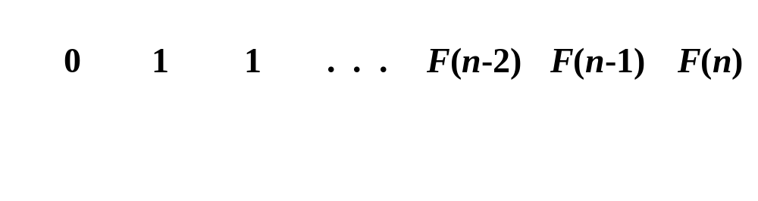
Fibonacci Numbers
  Computing the n^{th} Fibonacci number using a bottom-up approach:
  F(0) = 0
  F(1) = 1
  F(2) = 1+0 = 1
  …
  F(n-2) =
  F(n-1) =
  F(n) = F(n-1) + F(n-2)
Efficiency:
  Time – O(n)
  Space – O(n)

Slide 8
Fibonacci Numbers
The bottom-up approach is only Θ(n).
Why is the top-down so inefficient?
  Recomputes many sub-problems.
    How many times is F(n-5) computed?
  F(n)
  F(n-1) + F(n-2)
  F(n-2) + F(n-3) F(n-3) + F(n-4)
… … …
n levels

Slide 9
Fibonacci Numbers
Fib(5)
+
Fib(4)
+
Fib(3)
+
Fib(3)
+
Fib(2)
+
Fib(2)
+
Fib(1)
Fib(2)
+
Fib(1)
Fib(1)
Fib(0)
Fib(1)
Fib(0)
Fib(1)
Fib(0)

Slide 10
How to calculate Fibonacci Numbers faster?

Slide 11
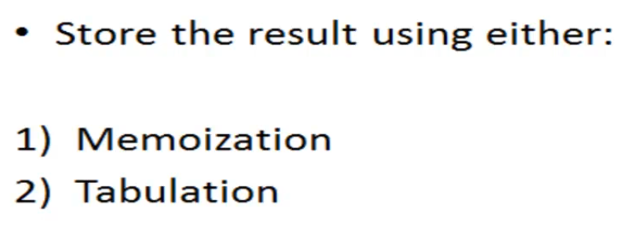
Solution

Slide 12
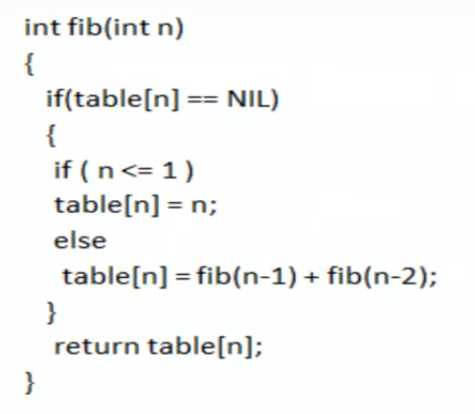
Momoization – Top Down

Slide 13
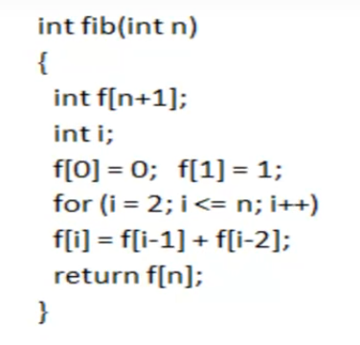
Tabulation – Bottom Up

Slide 14
